Slide 1
Java memory model overview

Slide 2
Agenda
Java memory partitions
Java object lifecycle
Java reference types

Slide 3
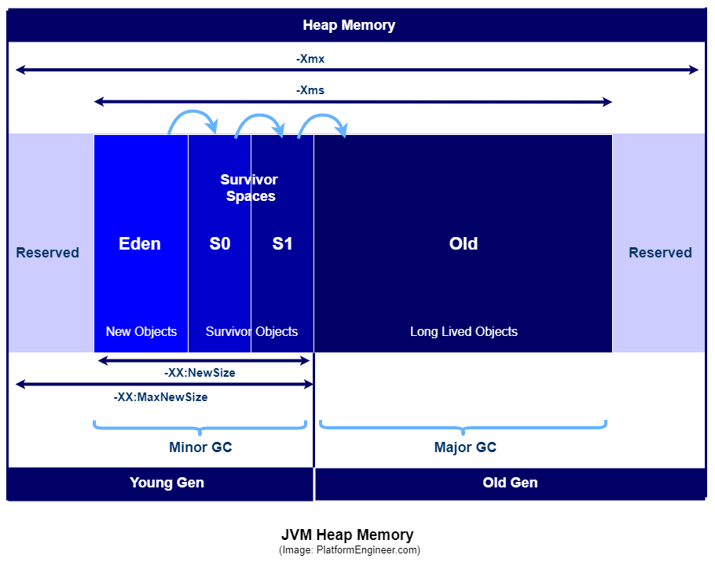
Java memory partitions

Slide 4
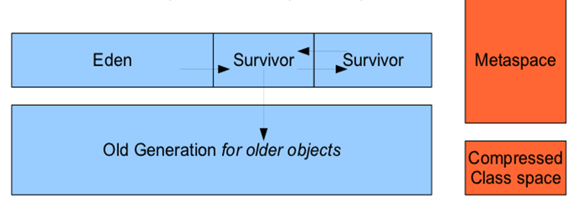
Memory allocation flow
Typical flow:
Eden -> (Survior0 <-> Survivor1) *15 times -> Old Generation

Slide 5
Java object lifecycle:
Created
In use
Invisible
Unreachable
Collected
Finalized
Deallocated

Slide 6
Java reference types:
Strong
Soft
Weak
Phantom

